Slide 1

MaharishI markandeshwar (deemed to be university)
Mullana, ambala
(Established under section 3 of the UGC Act 1956)
(NAAC Accredited Grade “A++” University)
M.M. ENGINEERING COLLEGE, MULLANA AMBALA
Department of computer science & Engineering
(NBA Accredited Department)
HARMONYHUB – A CULTURALLY INCLUSIVE MENTAL HEALTH PLATFORM
Bridging the gap in mental health care with teachnology and community
FAISAL RAZA |TEAM – DYNAMIC CODER’S | GDG HACKUREKA
RAVI KUMAR , PAWAN KUMAR, HIMANSHU KUMAR

Slide 2

INSPIRATION
Key Points:
Many people, especially those from diverse and marginalized communities, struggle in silence
because of the stigma surrounding mental health. They often feel unheard, unseen, and
without support.
Existing platforms lack cultural sensitivity and fail to foster a sense of belonging.
Our goal: To create a supportive, inclusive, and engaging digital mental health sanctuary.

Slide 3
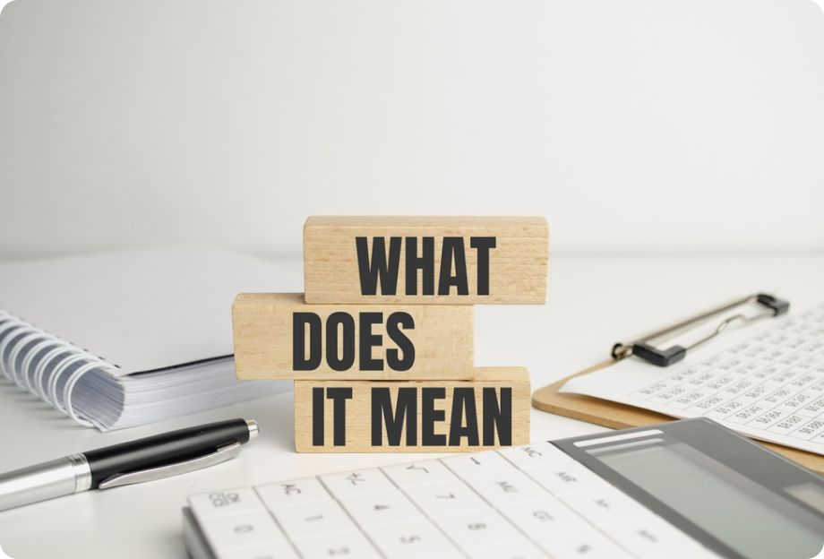
What It Does
Key Features:
Comprehensive Resource Hub: Blogs, playlists, webinars, and workshops.
Self-Assessment Tests: Culturally inclusive mental health evaluations
AI-Powered Chatbot: 24/7 support with personalized advice.
spiritual activities to relax your mind and recharge your energy. : Yoga, mindfulness, and entertainment.
Instant Support When You Need It : Direct access to professional support.
Community Support: WhatsApp & Discord groups for peer interaction.

Slide 4

How We Built It 🛠
Development Process:
1. Research & Planning: Understanding mental health needs & cultural gaps.
2. Design & Prototyping: Wireframing and UI/UX design
3. Tech Stack: HTML, CSS, JavaScript, PHP, Bootstrap.
4. AI Chatbot Integration: Implementing AI for real-time support.
5. Testing & Deployment: Ensuring seamless user experience.

Slide 5

Challenges & Achievements 🚧🏆
Challenges Faced:
Ensuring cultural sensitivity in content.
Technical difficulties with AI chatbot
integration.
Driving user engagement and community
interaction.
Accomplishments:
Successfully developed an AI-powered mental health chatbot.
Built a culturally inclusive and user-friendly platform.
Established a supportive mental health community.

Slide 6

What’s Next? 🚀
Future Plans:
Enhance AI chatbot for better personalization.
Develop a mobile app for wider accessibility.
Expand content & community outreach.
Implement Document Analysis Feature using OpenText API.
THANK YOU

